Slide 1

Health Monitoring System for Patients with Autism: with a Focus on Network Protocols
GROup 7
Data communications & Networks II
Course Project
Abdulla zain
Aiman Saad baig
Mahmoud ali
Mohamed sandouk
Yusuf siddiqui
Dr. Junaid Qadir

Slide 2

Table of contents
Introduction
Literature Review & Past works
Specifications
Brief overview
Project Implementation
Results and Contribution
Comparison and Testing
Conclusion

Slide 3

Introduction
What is our project about?
Why do we need it?
Abstract
Notes:
Aiman’s slide

Slide 4

Literature Review & Past works
As the medical field progresses further, our research gave us a thorough review of the existing works that have been theorized and currently exist in the market. Here, we’ll discuss a few of the works that are closely relevant to our project:
IoT in Healthcare: Trends and Challenges
Sensory Activities in Autism
IoT Protocols and Cloud Integration
Our research was not solely based on developing a product but focused on the networks application aspects of the product.

Slide 5

specifications
IoT implementation – Small-scale ESP32 prototype
Networks Aspect – MQTT protocol implementation with the cloud
User communication – SMS and Email notification
Notes:
Aiman’s slide

Slide 6

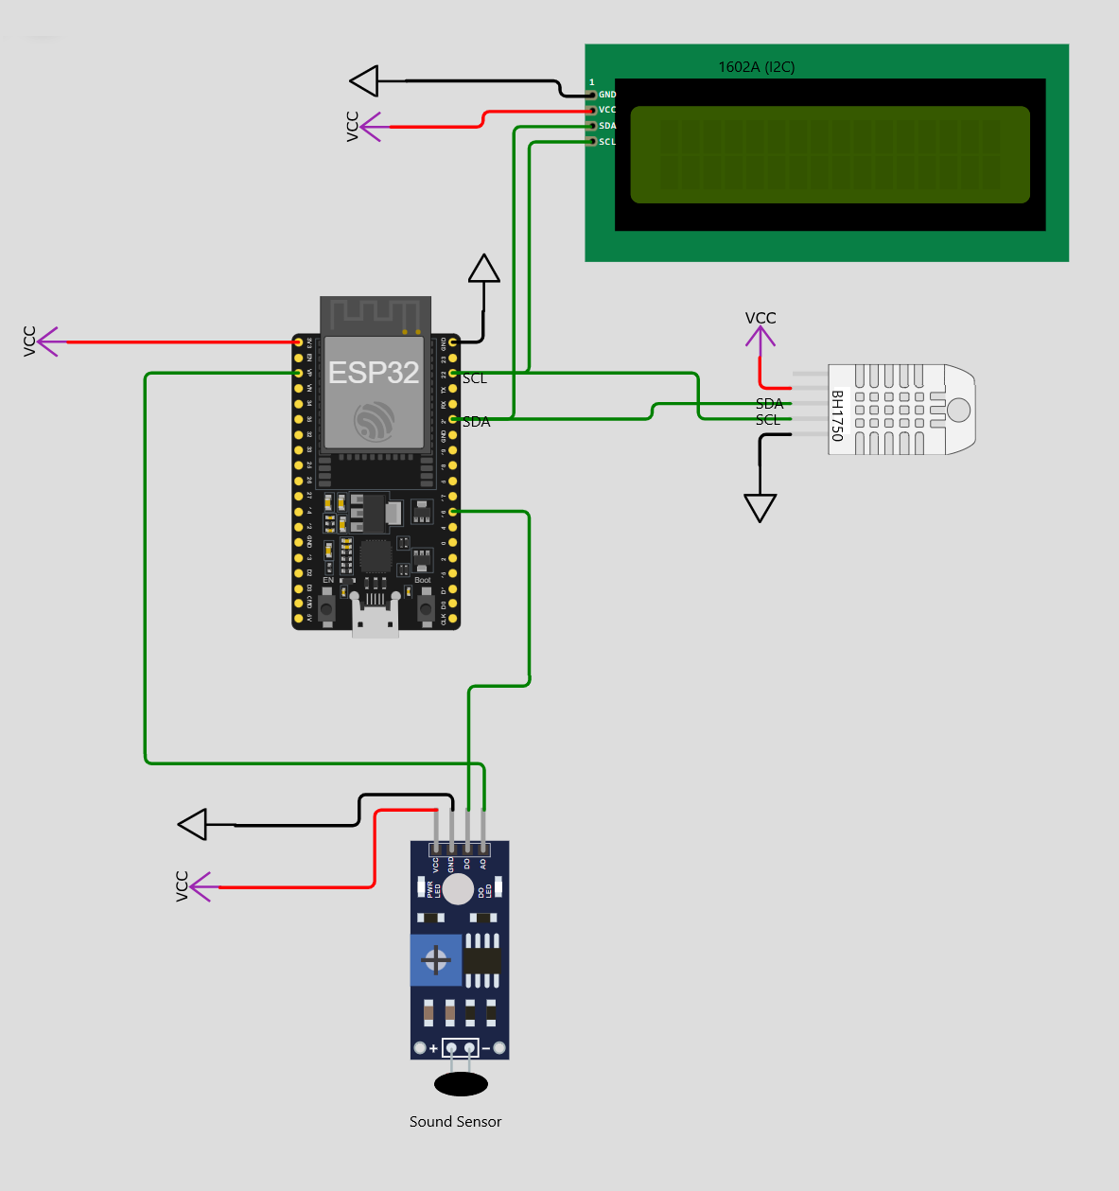


Brief system overview
Azure
Heroku
IoT Hardware Unit
Notification
Email
SMS

Slide 7

Project Implementation

Slide 8

Iot implementation with MCU
Appropriate connections have been made to implement the following sensors as per the specifications of our project:
Light Intensity sensor
Sound sensor

Slide 9

Iot implementation with MCU
Let’s take a look at why we chose ESP32 Wi-Fi board for implementing our project in contrast to other boards
Arduino Uno R4 Wi-Fi Board
NodeMCU ESP32 Wi-Fi Board
Standard MCU with built-in Wi-Fi capabilities
Issue faced:
Absence of relevant libraries to connect to the cloud over Wi-Fi
Released in June 2023
No SDK available
Attempted to use Arduino UNO with ESP8266 Wi-Fi module but we faced the same connectivity issues
Standard MCU with built-in Wi-Fi capabilities
Has built-in libraries to connect to the cloud using MQTT protocol
Cheaper
Compact & less power consumption

Slide 10
Brief system overview
Azure
Heroku
IoT Hardware Unit
Notification
Email
SMS

Slide 11





Cloud implementation - Azure
We’ll now be discussing the implementation of the cloud interface we used for our project – Microsoft Azure.
//
Message routing
//
IoT Hardware Unit
MQTT
SMTP
(STaaS)
Notes:
The IoT hardware unit repeatedly (hourly / threshold exceeded – timeout until 15mins) transmits information to Azure IoT Hub using MQTT protocol, where the message is then routed to Azure Blob Storage which is a Storage as a service (STaaS) module.
Azure functions requests data from Blob weekly. Then the email notification is sent to the caretaker using SMTP protocol.
-IoT Hub acts as a MQTT broker
-Azure functions have a python script which is deployed as a timer trigger to weekly generate a graph (with data of the past week) and email it as an image to the caretaker via SMTP protocol.

Slide 12
Brief system overview
Azure
Heroku
IoT Hardware Unit
Notification
Email
SMS

Slide 13


PaaS implementation - HEROKU
We’ll now be discussing the implementation of the PaaS we used for our project – Heroku
//
PaaS
//
IoT Hardware Unit
HTTP
Notes:
IoT hardware, upon being triggered due to an unsafe incident, sends a message to Heruko (is a cloud PaaS enabling developers to build, run and develop applications entirely on a cloud) using HTTP POST request. This occurs only when an incident occurs and not as a repeated loop like with Azure implementation bcuz…. ….hence not wasting resources.
-On Heruko, a python script is deployed – which utilizes Twilio to send an SMS.

Slide 14

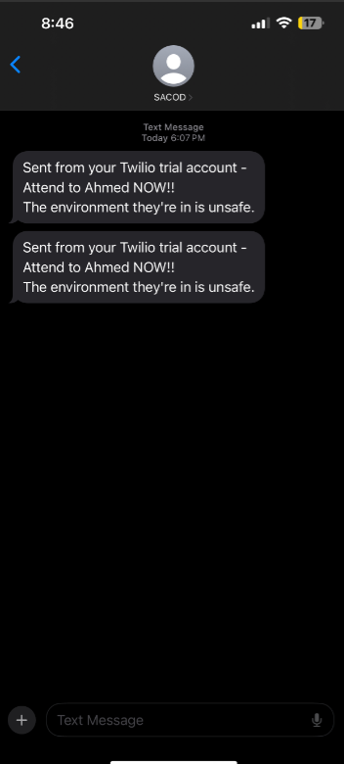
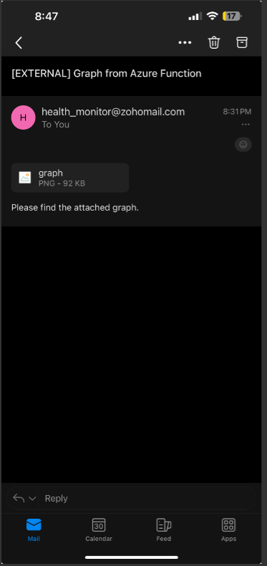
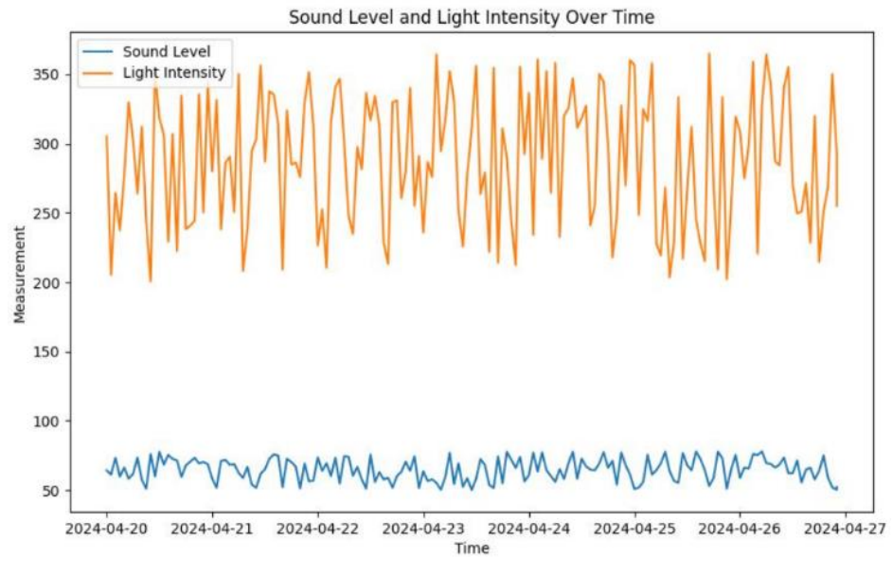
Results & Contribution
Results
We were able to successfully complete our project, which was demonstrated by the successful transmission of the SMS and email as required with the help of the relevant platforms and networking protocols as discussed.

Slide 15
Results & Contribution
Project’s Contribution
Our project can contribute to the society in a variety of ways.
Positive response from QU CMED students
Unique methodology
Similar IoT products existing in the marketplace but none that stresses on noise and light intensities as a measure for the issue.
Notes:
Our project can contribute to the society in a variety of ways. Based on our discussions with students from QU CMED, we got a positive response of interest in the methodology out project uses to analyse patients with autism. Overall, based on our research, we found similar IoT products existing in the market place but none that stresses on noise and light intensities as a measure for the issue.

Slide 16

Comparison & testing
Comparison
Product | Description
Google Nest | Includes Thermostats, Smoke detectors, and security systems such as smart doorbells and cameras that sends notifications directly to smartphone
Lief Therapeutics | Smart patch monitors heart rate and can signal the user about stress levels, potentially linked to overwhelming stimuli like loud noise or bright lights
Health Monitoring System for Patients with Autism (Our Product) | Given the above products which are close to the desired variables needed to alert danger to autistic patient, no product directly measures the lights or noise values as our project

Slide 17
Comparison & Testing
Average Error: | 26.38
Average Error: | 0.44

Slide 18
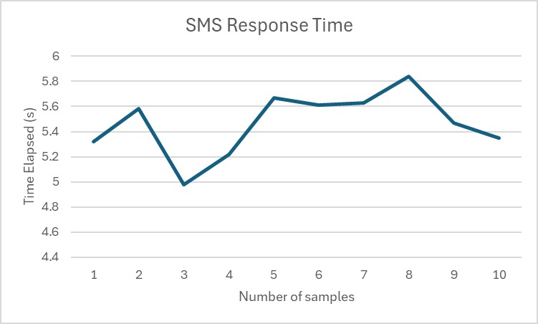
Comparison & Testing

Slide 19

CONCLUSION
Team Contribution
TEAM MEMBER | CONTRIBUTION
Abdullah Zain | Literature Review, Technical reports, Informed Judgement report
Aiman Saad Baig | Hardware connections, Arduino code, Presentation, Revise and review entire technical report
Mahmoud Ali | Hardware connections, Complete Azure deployment, Complete SMS-related deployment, Troubleshooting
Mohamed Sandouk | Literature review, Technical reports, Informed judgment report, SMS-related deployment
Yusuf Siddiqui | Hardware connections, Complete Azure deployment, Troubleshooting

Slide 20
CONCLUSION
Key points learnt
Azure cloud implementation
PaaS (SMS) implementation
Limitations of certain MCU
MQTT, HTTP, SMTP, SNTP networking protocols
Various testing criteria
Time management and coordination

Slide 21


